Slide 1

PotterMania

Slide 2
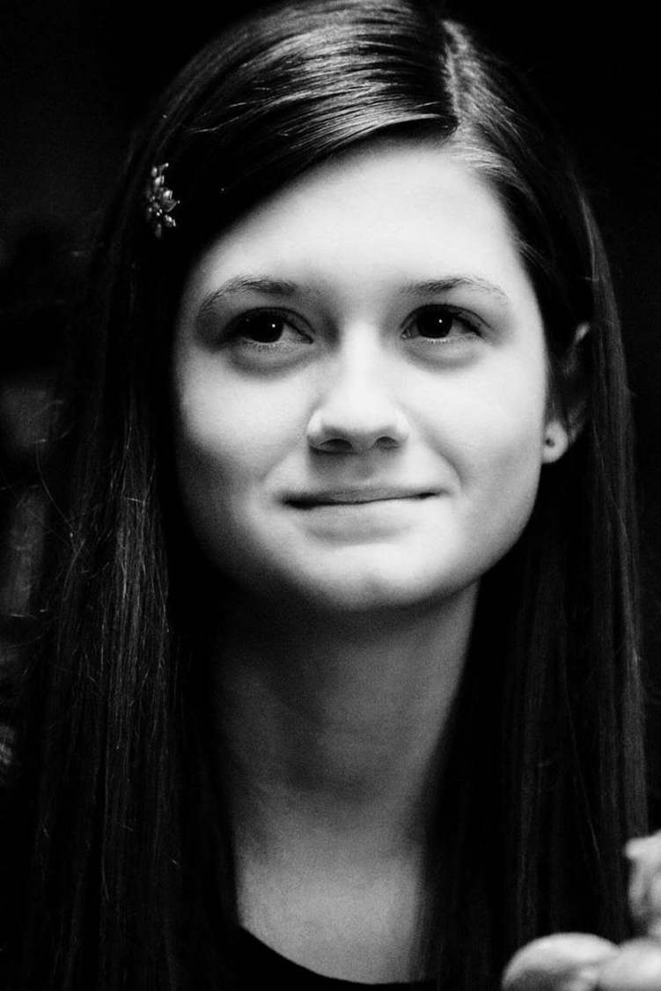
The rules
20 Questions.
Each question carries the same amount of marks.
Certain questions have a bonus part, which will be used to break ties.
No negative marking

Slide 3
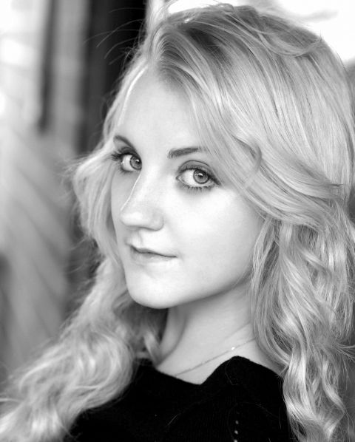
Good luck
Good Luck

Slide 4
In the wizarding world the _________ is considered to be the omen of death.

Slide 5
We Love Hermoine
What is Hermoine’s middle name?

Slide 6
What gift did Harry get for his 11th birthday ?

Slide 7
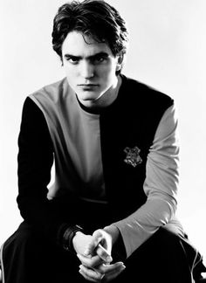
Name the house ghost of the Hufflepuffs

Slide 8
Other than Hermoine, Harry and Ron, S.P.E.W contains two other confirmed members.
Name them. (part points will be awarded)

Slide 9
Macbeth
The _________ are a very popular band in the Wizarding World and on the Wizarding Wireless Network. Albus Dumbledore booked them to perform in Hogwarts at the 1994 Yule Ball. Despite their names, all 8 members are male.

Slide 10
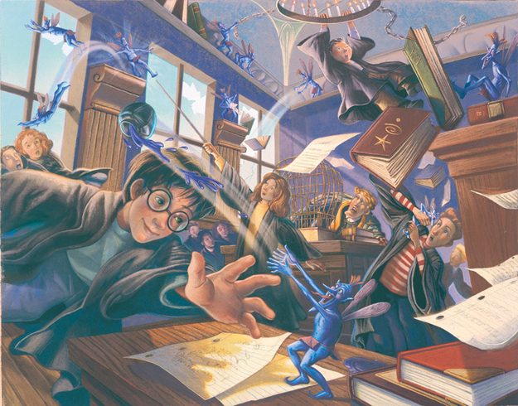
Name these creatures.
7

Slide 11
Where would you be if you were looking at this?
Enter, stranger, but take heed Of what awaits the sin of greed For those who take, but do not earn Must pay most dearly in their turn So if you seek beneath our floors A treasure that was never yours Thief, you have been warned, beware Of finding more than treasure there

Slide 12
Who is the professor of astronomy at Hogwarts?

Slide 13
“….that I have somehow hoodwinked him? Fooled the Dark Lord, the greatest wizard, the most accomplished Legilimens the world has ever seen?”- Severus Snape(Half blood prince)
However fans have speculated for years that X is actually the most powerful legilimens. Who is X?

Slide 14
The _._._._._._ was a series of tests presented on J.K. Rowling's Official Site, prior to its 2012 redesign. Presented partially as a Harry Potter trivia test, there is nevertheless additional information that can be gleaned from the questions.
Amusingly, Neil Murray, the husband of J. K. Rowling, took the first _._._._._._ and only achieved a score of Acceptable, despite being in the same room as his wife when she was composing the quiz and listening to her read the answers out loud. This discouraged him from attempting either of the following two tests.
(Pic in next slide)

Slide 15

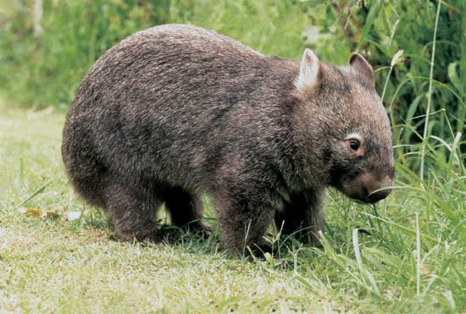
Identify the test

Slide 16
Who is the Founder and anchor of PotterWatch?

Slide 17
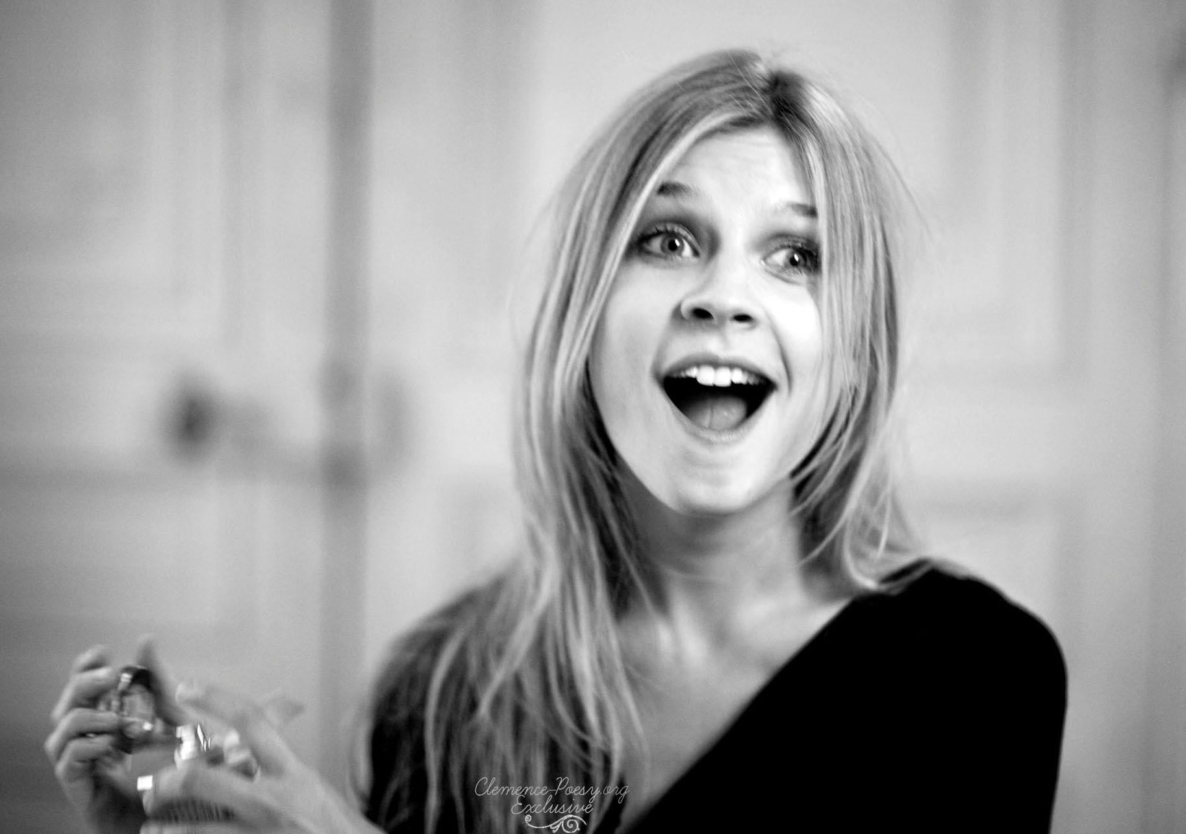
What nickname do the kids( especially Ginny) use to refer to Fleur Delacour ?

Slide 18
Identify the spell used

Slide 19
<Video>

Slide 20
Which is the only Harry potter movie to not feature Lord Voldemort?

Slide 21
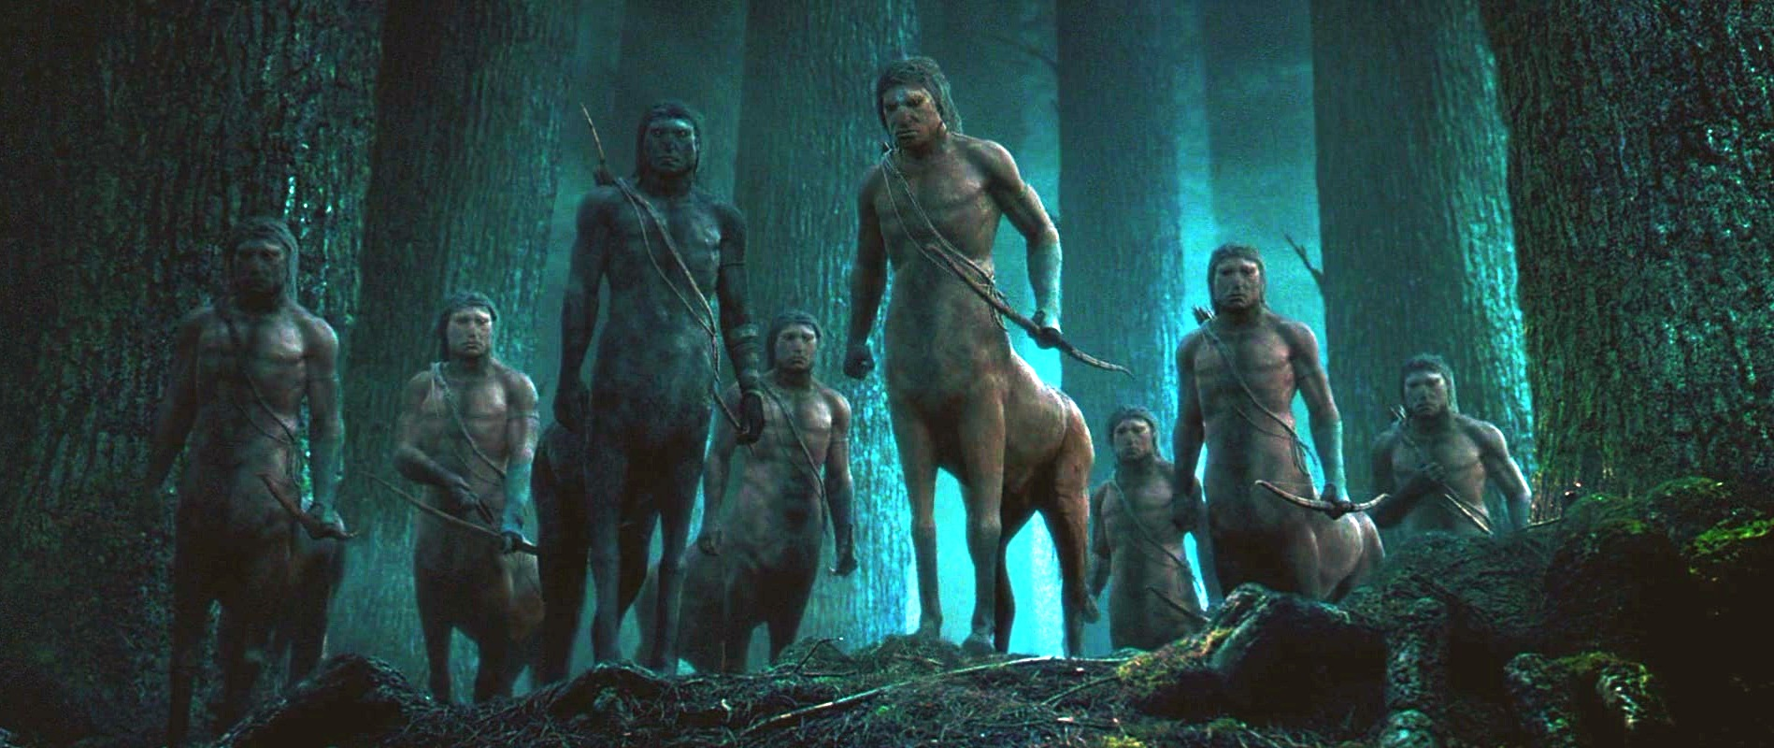
Name any 3 centaurs (no part points) Tie-breaker Bonus for 4 centaurs!
16

Slide 22
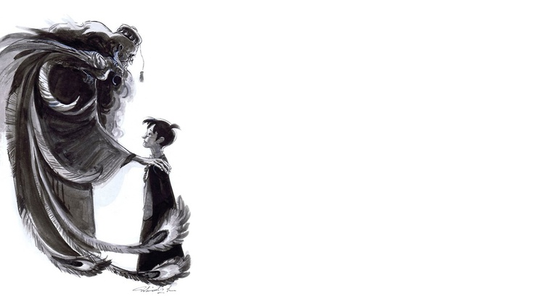
Name any two titles held by Albus Dumbledore. (Other than Headmaster, Hogwarts.) Bonus points if 3 titles are mentioned!
17

Slide 23
Identify this structure
18
Pic in next slide

Slide 24
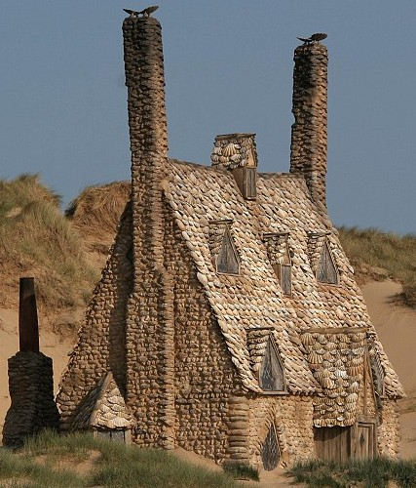

Slide 25
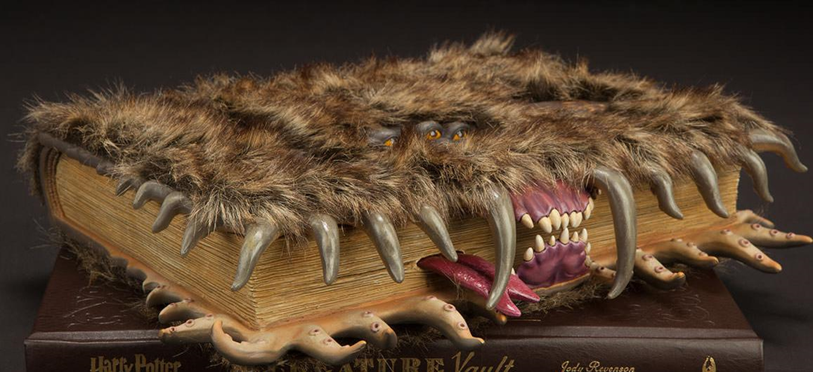
Which book is this?
19

Slide 26

Identify the composer for this particular theme. (Tie-breaker Bonus for naming the track name!)
20

Slide 27
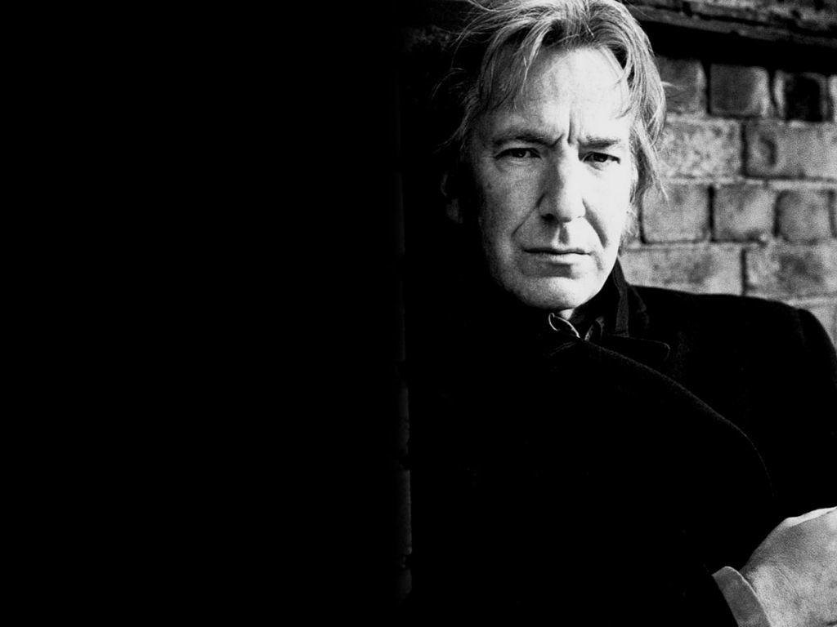
Thank You In the memory of Alan Rickman

